Slide 1
IPA
Intelligent parking assistant

Slide 2
Front End Conceptualization
INITIAL GLOBAL VARIABLES
User = None /* global */
message = None /* global */
possible_parking = null /* global */
Location = null /* global */
navigation = null /* global */

Slide 3
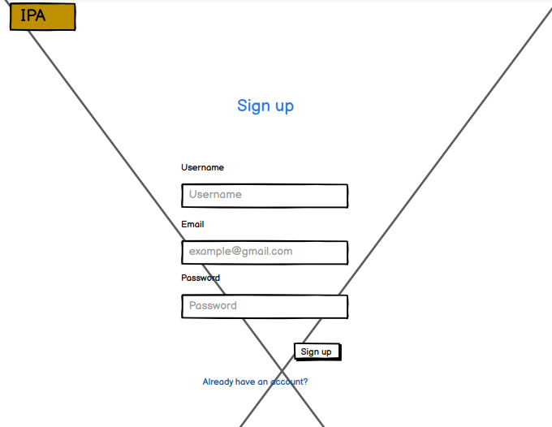
SIGNIN AND LOGIN PAGE
START
IF user_has_account THEN
TRY
AWAIT Regiser_new_user
Set message
Redirect to login page
CATCH
Set message
Display Error popup
FINALLY
Display message
SIGN UP PAGE

Slide 4
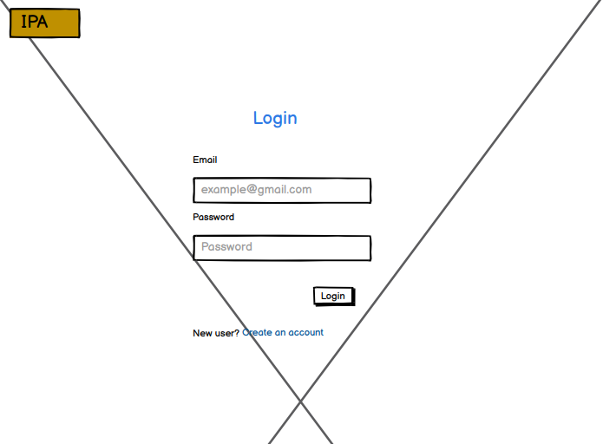
ELSE
TRY
AWAIT Login
Set message
Set user
Redirect to landing page
CATCH
Set message
Display Error popup
FINALLY
Display message
END IF
END
LOGIN PAGE

Slide 5
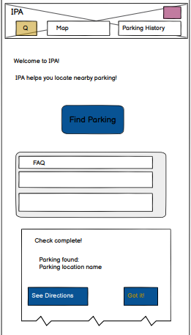
IF USER CLICKS NAVIGATION
location = input “Enter user Location”
/* set when user is redirected to this page initially*/
display Landing Page
navigation = input “Enter Page to view”
IF navigation == landing THEN
Redirect to navigation
IF navigation == Map page THEN
Redirect to Map page
ELSE IF navigation == history page THEN
Redirect to show history page
ELSE IF navigation == current page THEN
Display landing
ELSE
Display Error Page
END IF
LANDING PAGE

Slide 6
WHEN USER CLICKS FIND PARKING
location = input “Enter user Location”
IF Current_location != null THEN
TRY
AWAIT Search for parking
Set message
Set possible_parking
Display Options Popup
CATCH
Set message
Finally
Display message
ELSE
Set message
Display Error popup
END IF
LANDING PAGE

Slide 7
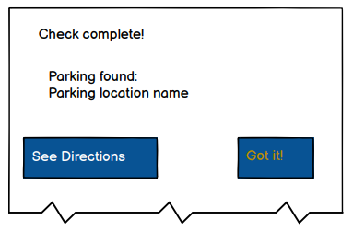
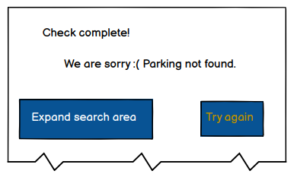
WHEN USER CLICKS SHOW DIRECTIONS IN OPTIONS POPUP
START
IF possible_parking != null THEN
display Options popup with link to map page
ELSE
display Options popup to expand search area
END IF
END
OPTIONS POPUP

Slide 8
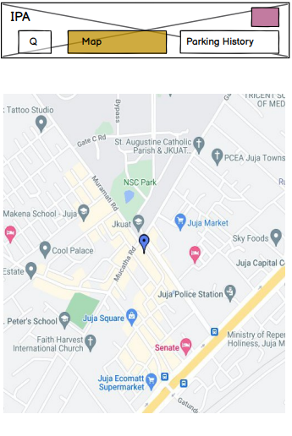
WHEN USER CLICKS SHOW DIRECTIONS IN OPTIONS POPUP
START
Redirect to map page
Display parking space found
END
MAP PAGE

Slide 9
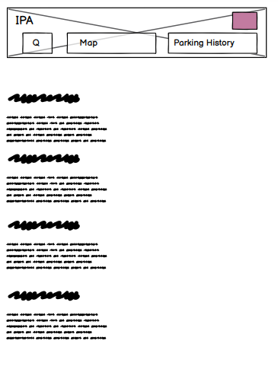
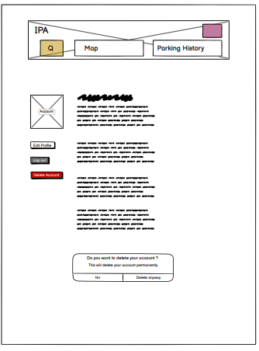
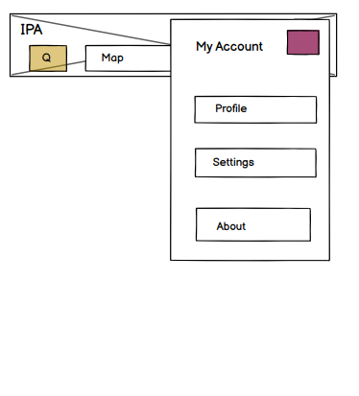
WHEN USER CLICKS USER ICON IN NAVIGATION
Display options to navigate to the pages shown below
ABOUT PAGE
ACCOUNT PAGE
NAVIGATION POPUP

Slide 10
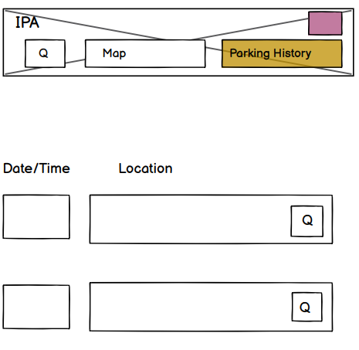
HISTORY PAGE
HISTORY PAGE
START
history = null /* local */
IF history != null OR history.length != 0 THEN
Fetch history data
set history
Display list of history
ELSE
Display as text no history saved yet
END IF
END

Slide 11
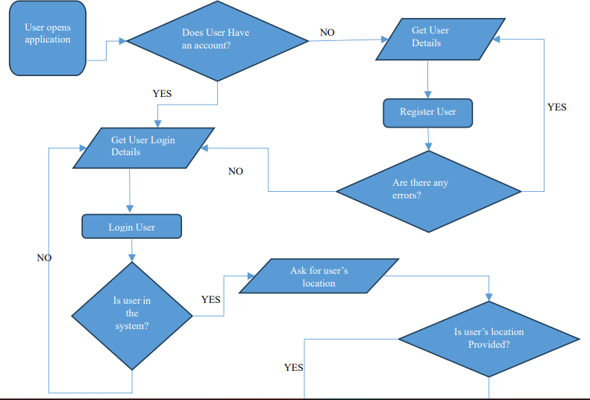
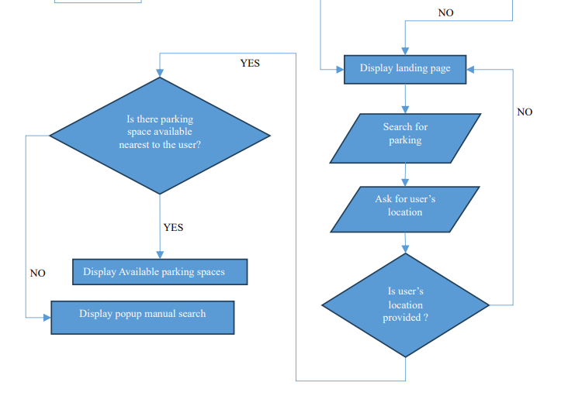
FLOW CHART DIAGRAM

Slide 12
Backend Conceptualization
Once the user searches for parking, we get the user's co-ordinate, then we query the database for all parking's within 1km radius.
We return an array of coordinates starting from the closest to the furthest.
We then search for images of the given coordinates using Google maps API or the CCTV feeds
Supply the images to the machine learning model determine if there are any free spaces.
Return true or false, then if true, give the coordinate to the user.

Slide 13
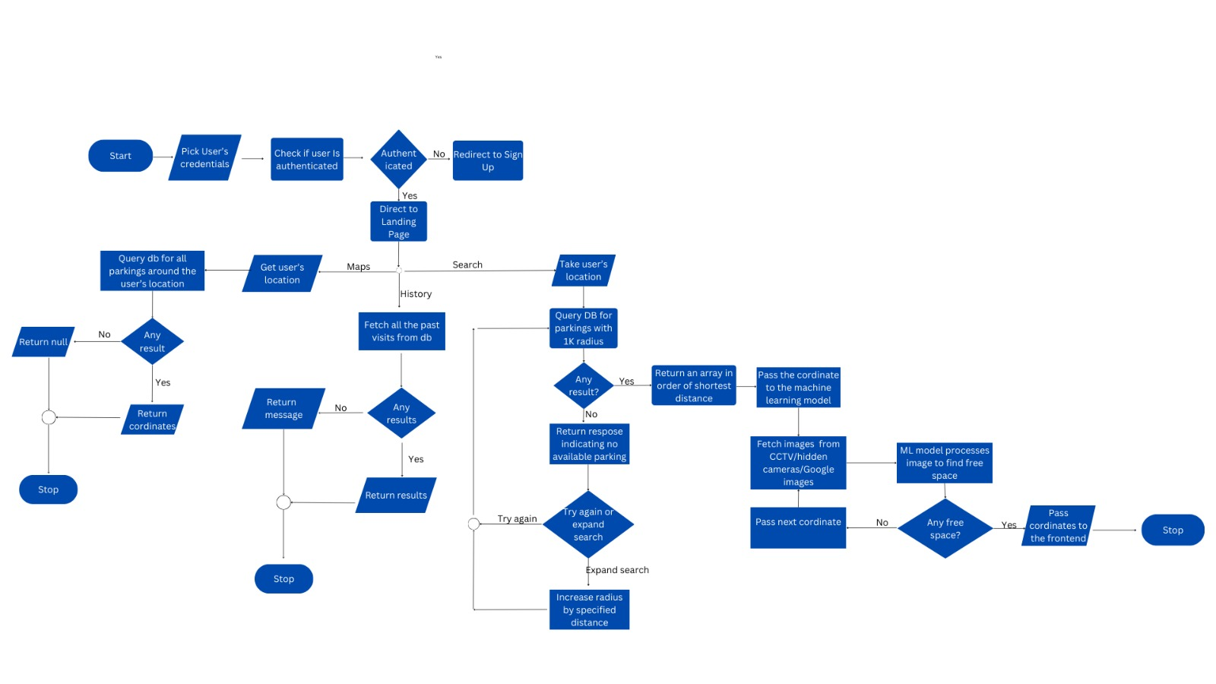
FLOW CHART DIAGRAM

Slide 14
AUTHENTICATION OF USER
START
INPUT email, password
IF not authenticate(email, password):
Send 403 message
Direct to sign up page
ELSE:
Direct to search page
STOP

Slide 15
SEARCH ALGORITHM
START
INPUT location
if not location:
ask for location
else:
search DB for closest parkings
return array cordinates of closest parking in order of shortest distance
if cordinates:
free_parking = null
while free_parking=== null:
fetch images from either google maps, CCTV footages or hidden cameras.

Slide 16
if images:
pass images to machine learning model
if free space:
free parking = cordinate
else:
get next_cordinate
else:
return no cordinates found
STOP

Slide 17
HISTORY ALGORITHM
START
visits = null
get visits based on user's details
if visits:
return visits
else:
return no visits yet
STOP

